Slide 1
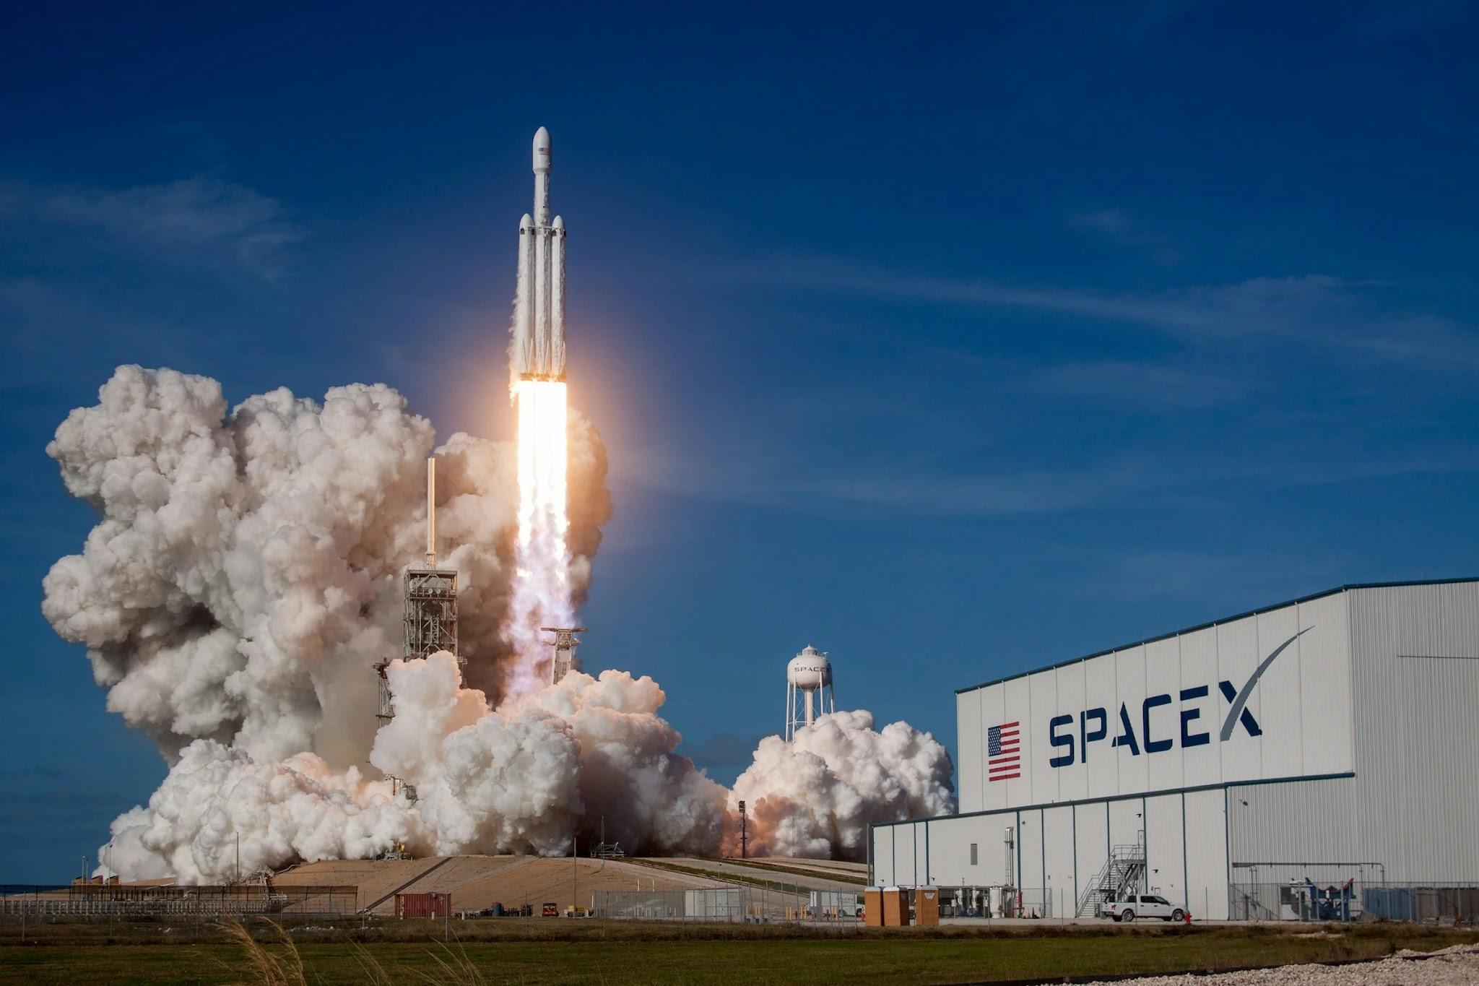
Predicting Success: A Data-Driven Analysis of SpaceX Falcon 9 Landings
Using Machine Learning
IBM Certification Course Project
By: James Montoya
Github Repo
Image source: https://www.google.com.co/url?sa=i&url=https%3A%2F%2Fwww.environmentenergyleader.com%2F2024%2F04%2Fspacex-reuses-falcon-9%2F&psig=AOvVaw2nbyyOzCOoICbO9VKHDdgF&ust=1725847008515000&source=images&cd=vfe&opi=89978449&ved=0CBQQjRxqFwoTCJD0qKSfsogDFQAAAAAdAAAAABAE

Slide 2
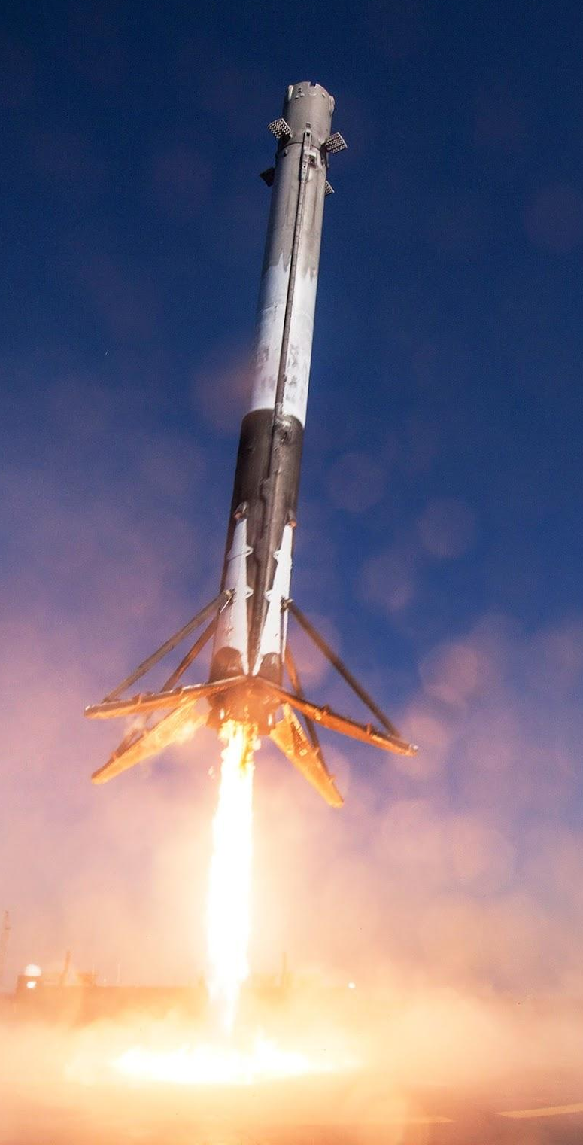
Executive Summary
SpaceX has revolutionized the commercial space industry with its cost-effective Falcon 9 rocket launches, made affordable by reusing the rocket’s first stage. To compete in this market, predicting whether the Falcon 9’s first stage will land successfully is crucial, as it directly impacts launch costs.
This analysis adopts a data science approach to predict landing success. We collected and cleaned public data on Falcon 9 launches, performed exploratory data analysis (EDA) to identify key factors influencing landings, and developed predictive models using machine learning techniques. The resulting insights can guide new competitors like “Space Y” in strategic decision-making and cost optimization.
Image source: https://media.wired.com/photos/59443cbf3cf71b16ba5b9e1d/master/w_2240,c_limit/Rocket-Art-531752474.jpg

Slide 3

Introduction
The commercial space age has begun, with private companies making space travel more accessible and affordable. Companies like Virgin Galactic, Rocket Lab, and Blue Origin are pioneering different aspects of space exploration. However, SpaceX stands out as one of the most successful players in the field. SpaceX’s notable achievements include missions to the International Space Station, the creation of the Starlink satellite internet constellation, and launching manned missions into space.
One of the reasons for SpaceX’s success is its relatively low-cost rocket launches. The Falcon 9 rocket, for example, is offered at $62 million per launch, while other providers charge upwards of $165 million. A significant part of these savings comes from SpaceX’s ability to reuse the first stage of its rockets. This first stage does most of the heavy lifting to propel the payload toward orbit. Its recovery is crucial to maintaining low launch costs, but it is not always guaranteed due to mission parameters or technical difficulties.
In this presentation, we will analyze data from SpaceX for a the new competitor Space Y. Our goal is to estimate the cost of rocket launches and predict whether the Falcon 9’s first stage will successfully land and be reusable. Instead of relying solely on rocket science, we will use machine learning models trained on public data to make these predictions and help our team develop competitive strategies.
Image source: https://www.economist.com/cdn-cgi/image/width=1424,quality=80,format=auto/sites/default/files/images/print-edition/20180120_LDD002_0.jpg

Slide 4
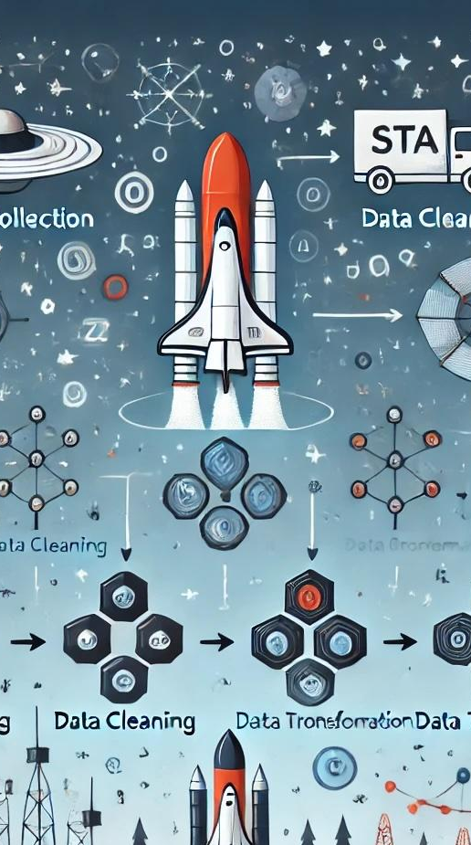
Data Collection and Data Wrangling
The data for this project was collected from publicly available sources, including API SpaceX's sources, cvs files and web scraping methods using beautifulsoup in wikipedia website. The data includes information on each Falcon 9 launch, such as launch date, landing site, payload mass, weather conditions, and landing success among others.
Data Acquisition
Collecting data from various sources, ensuring data quality, and performing initial cleaning.
Data Cleaning and Transformation
Addressing null values, filtering values, and transforming data into a suitable format for machine learning algorithms.
Data Exploration
Analyzing the collected data to identify patterns, relationships, and potential features for the model.
Image source: Image created by DALL-E, September 2024.

Slide 5
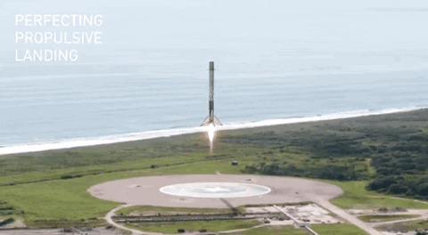

Outcomes predicted
Class: 0 .
Not Successfully landed
Class: 1 .
Successfully landed
The goal is to classify the landing outcomes of the Falcon 9 boosters into two distinct categories:
Class 0: Represents a bad outcome where the booster did not successfully land.
Class 1: Represents a good outcome where the booster successfully landed.
The classification variable, Y, will be used to indicate the outcome of each launch, with values of either 0 or 1, providing a clear, binary distinction between successful and unsuccessful landings. This classification will help in analyzing and predicting future landing success rates for cost optimization and competitive positioning.
Image source: https://cf-courses-data.s3.us.cloud-object-storage.appdomain.cloud/IBMDeveloperSkillsNetwork-DS0701EN-SkillsNetwork/api/Images/landing_1.gif
Image source: https://cf-courses-data.s3.us.cloud-object-storage.appdomain.cloud/IBMDevelo
perSkillsNetwork-DS0701EN-SkillsNetwork/api/Images/crash.gif

Slide 6
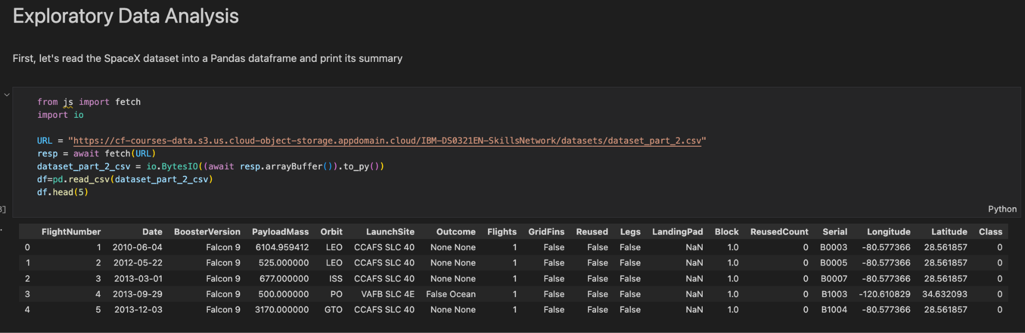
EDA and interactive visual analytics methodology
Image source: local python file running in Visual Studio Code (1.92.2) in Macbook Pro M1
This data is intended to help analyze the factors influencing the success or failure of SpaceX’s rocket landings. The columns provide comprehensive details about each launch, such as the payload mass, launch site, and booster specifications, which can be used to build predictive models and gain insights into the landing outcomes.

Slide 7
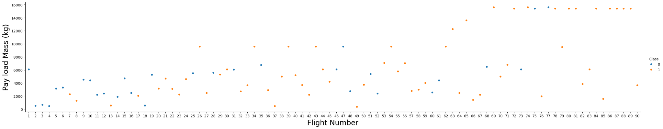
Relationship between Flight Number (x-axis) and Payload Mass (kg) (y-axis)
Image source: local python file running in Visual Studio Code (1.92.2) in Macbook Pro M1
The chart shows that SpaceX’s landing success rate improves over time, regardless of payload mass. While payload mass varies, it does not directly determine success, suggesting other factors also influence landing outcomes.

Slide 8
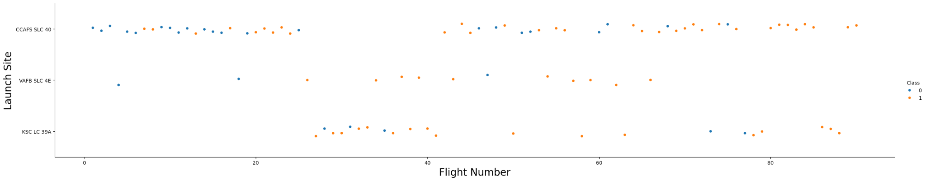
Relationship between Flight Number and Launch Site
Image source: local python file running in Visual Studio Code (1.92.2) in Macbook Pro M1
The success of the Falcon 9 first stage landings tends to improve over time, with variations between different launch sites. The data suggests that some sites, particularly KSC LC 39A, may offer conditions or configurations more conducive to successful landings in recent flights.

Slide 9
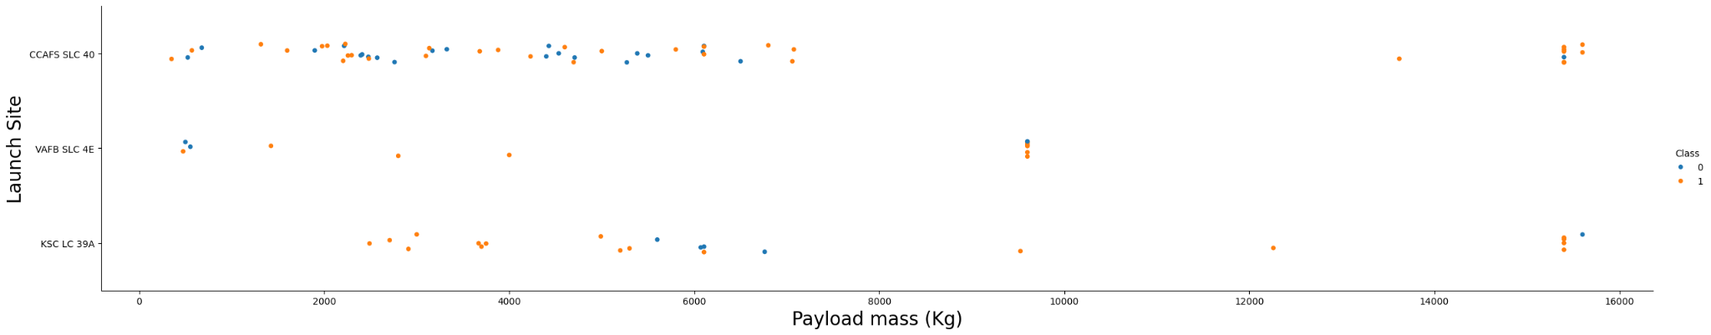
Relationship between Payload Mass and Launch Site
Image source: local python file running in Visual Studio Code (1.92.2) in Macbook Pro M1
Launch sites are chosen partly based on payload mass, with heavier payloads launching from specific sites. Landing success appears to be independent of payload mass, indicating that other factors contribute to the outcomes.
Observing Payload Mass Vs. Launch Site scatter point chart we can see that the VAFB-SLC launchsite there are no rockets launched for heavy payload mass(greater than 10000).

Slide 10
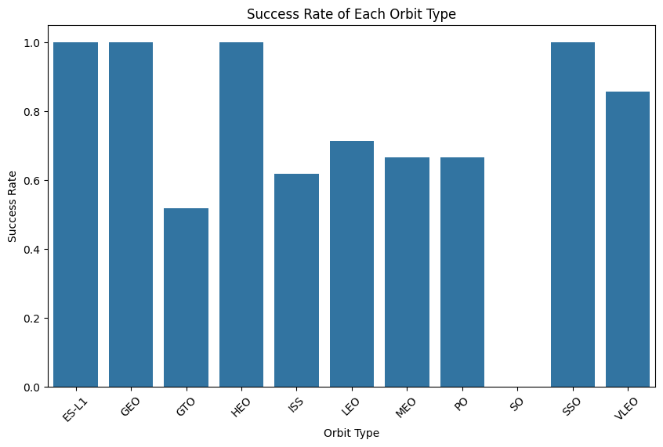
Relationship between success rate of each orbit type
Image source: local python file running in Visual Studio Code (1.92.2) in Macbook Pro M1
ES-L1, SSO, and VLEO have the highest success rates, close to or at 100%. This suggests that launches targeting these orbits have been very reliable in achieving successful outcomes.
Orbit type plays a critical role in the success rate of launches. Some orbits like ES-L1, SSO, and VLEO are more consistently successful, while others, such as GEO and HEO, present more challenges.

Slide 11
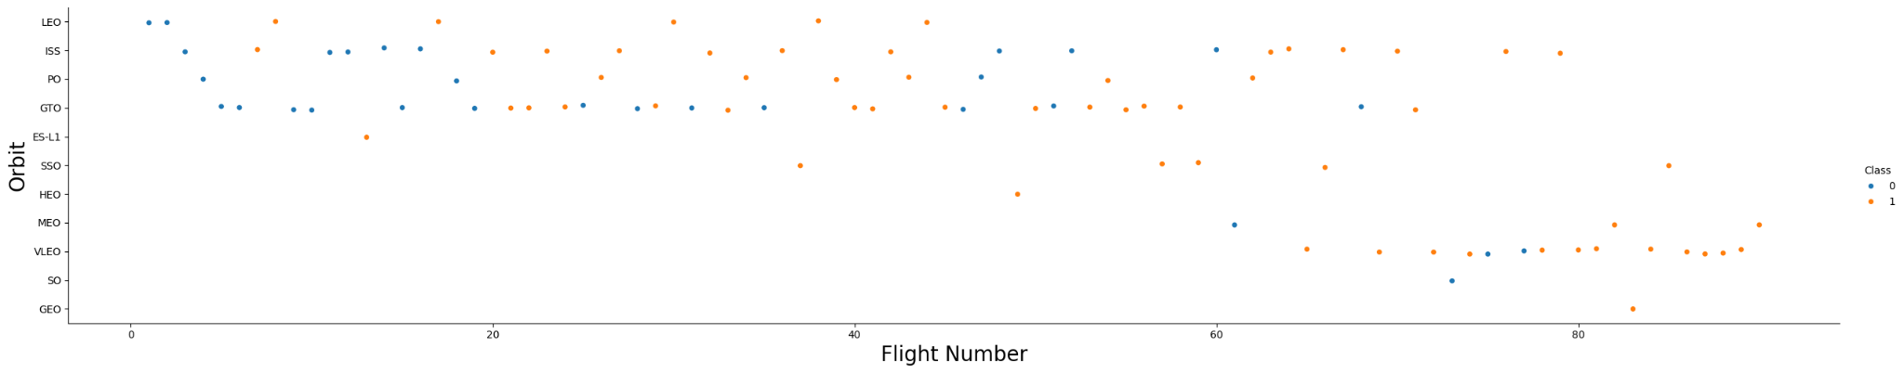
Relationship relationship between FlightNumber and Orbit type
Image source: local python file running in Visual Studio Code (1.92.2) in Macbook Pro M1
We can observe that in the LEO orbit, success seems to be related to the number of flights. Conversely, in the GTO orbit, there appears to be no relationship between flight number and success.

Slide 12
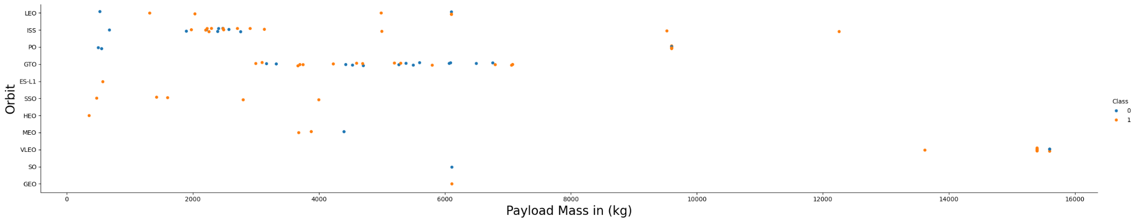
Relationship between Payload Mass and Orbit type
Image source: local python file running in Visual Studio Code (1.92.2) in Macbook Pro M1
With heavy payloads the successful landing or positive landing rate are more for Polar,LEO and ISS.
However, for GTO, it's difficult to distinguish between successful and unsuccessful landings as both outcomes are present.

Slide 13
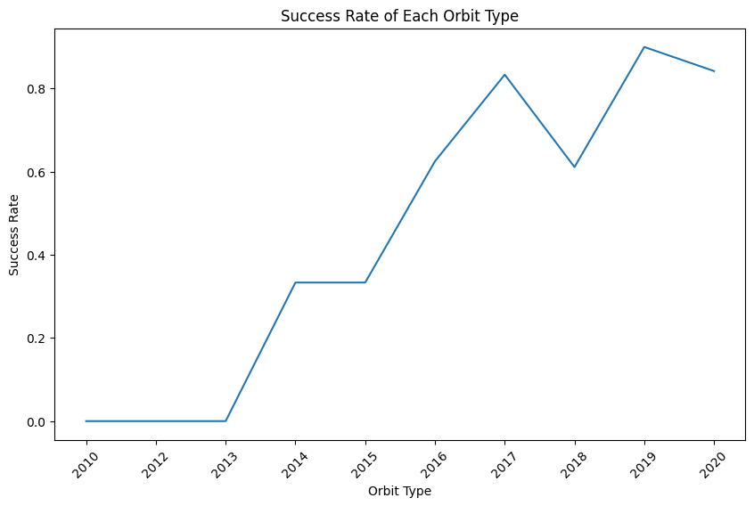
Launch success yearly trend
We can observe that the success rate since 2013 kept increasing till 2020

Slide 14
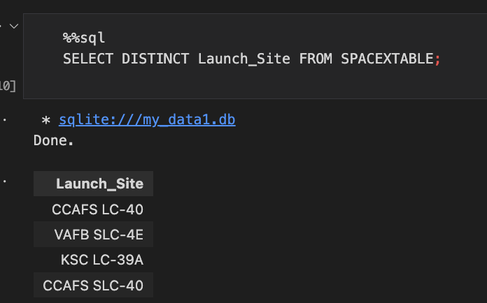
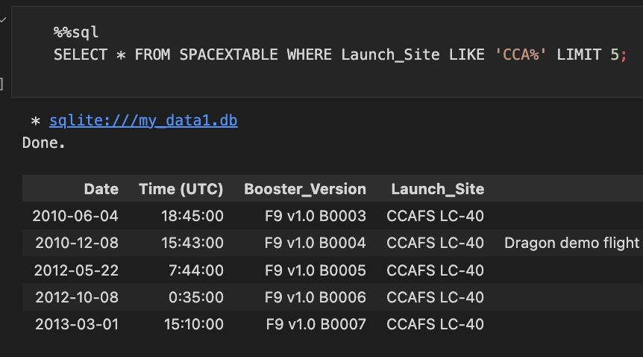
Exploratory Data Analysis (EDA) Using SQL Queries
Another effective method for data analysis in a notebook environment is using SQL queries. This approach enables us to execute SQL statements directly within the notebook cells, leveraging a simple wildcard to interact with the data seamlessly.
Displaying the names of the unique launch sites in the space mission
Displaying 5 records where launch sites begin with the string 'CCA'

Slide 15
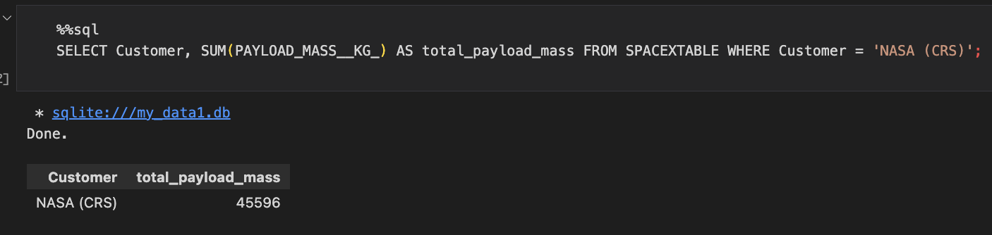
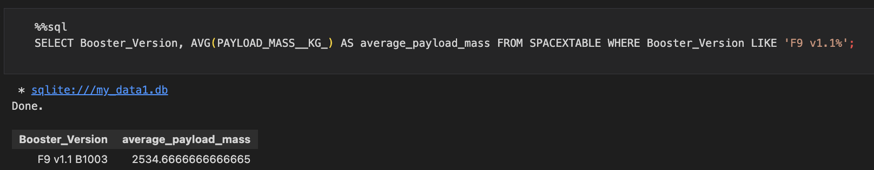
Exploratory Data Analysis (EDA) Using SQL Queries
Displaying the total payload mass carried by boosters launched by NASA (CRS)
Displaying average payload mass carried by booster version F9 v1.1

Slide 16
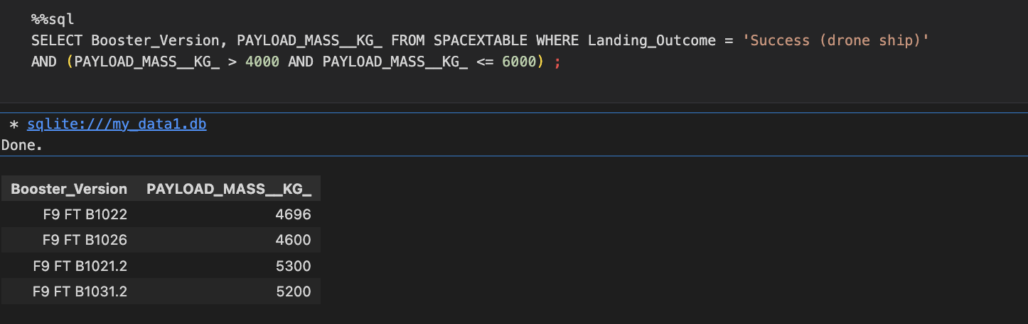
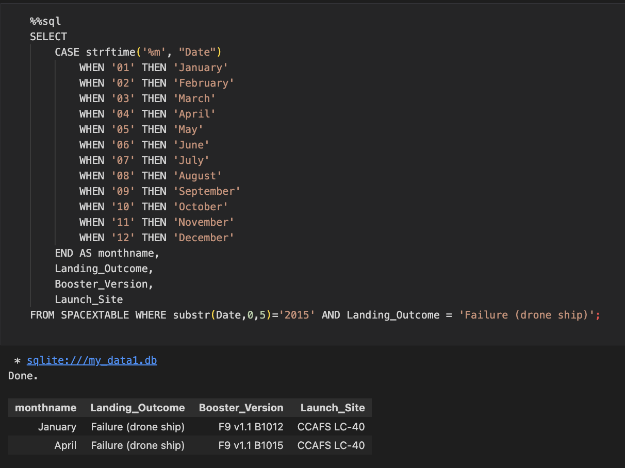
Exploratory Data Analysis (EDA) Using SQL Queries
Displaying average payload mass carried by booster version F9 v1.1
Displaying the List of records which will display the month names, failure landing_outcomes in drone ship ,booster versions, launch_site for the months in year 2015.

Slide 17

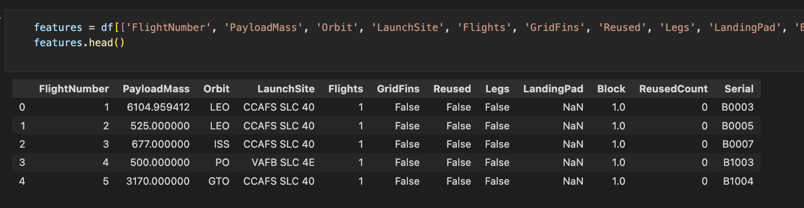
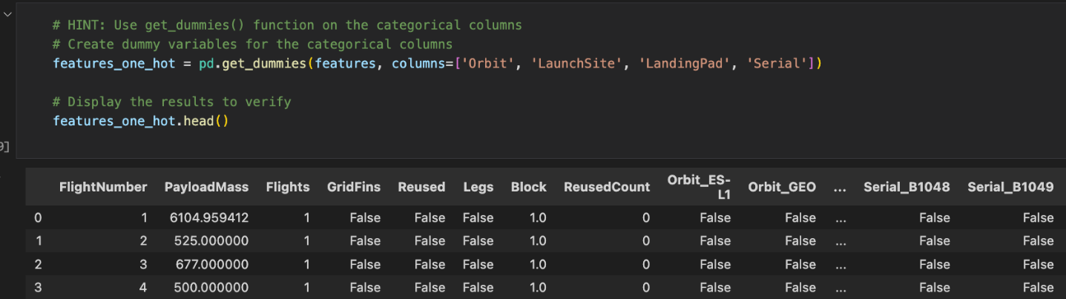
Features Engineering
Getting preliminary insights about how each important variable would affect the success rate, we will select the features that will be used in success prediction in the future module.
Now we apply the one hot encode to create dummies columns in order to prepare the data for the machine learning algorithms.
Image source: Image created by DALL-E, September 2024.

Slide 18
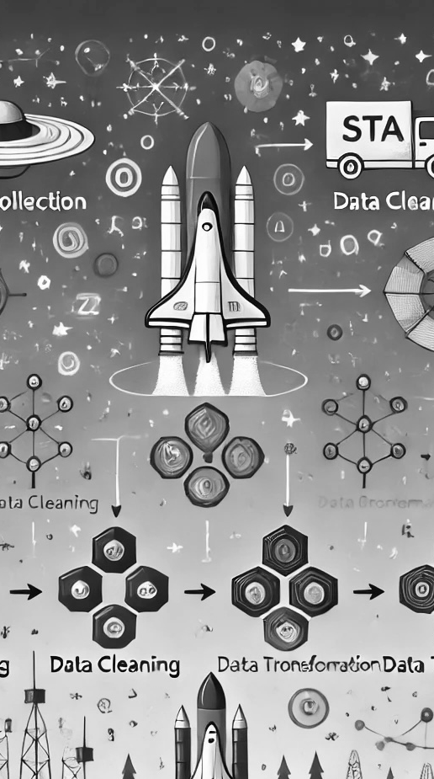
Predictive analysis methodology
Objective: To develop a machine learning model that predicts the success of Falcon 9 first-stage landings.
Data Preparation: Collected and cleaned SpaceX launch data, including features like flight number, payload mass, launch site, orbit type, and booster specifications.
Feature Engineering: Selected key features influencing landing outcomes, such as weather conditions, payload mass, and launch configurations, and transformed them into a suitable format for model training. Use One hot encoding.
Data Standardization: Standardized the dataset to ensure all features are on a comparable scale, improving model performance and convergence speed.
Model Selection: Evaluated various classification algorithms, including Logistic Regression, Support Vector Machine, Decision Trees, and k nearest neighbors KNN, to find the most accurate predictor, using a GridSearchCV object to optimize hyperparameters for each model.
Model Training and Evaluation: Split the data into training and test sets, trained the models, and evaluated their performance using metrics like accuracy score and the confusion matrix to assess true vs. false predictions.
Outcome: Identified the two best-performing model for predicting landing success, providing actionable insights to optimize future SpaceX missions.
Image source: Image created by DALL-E, September 2024.

Slide 19
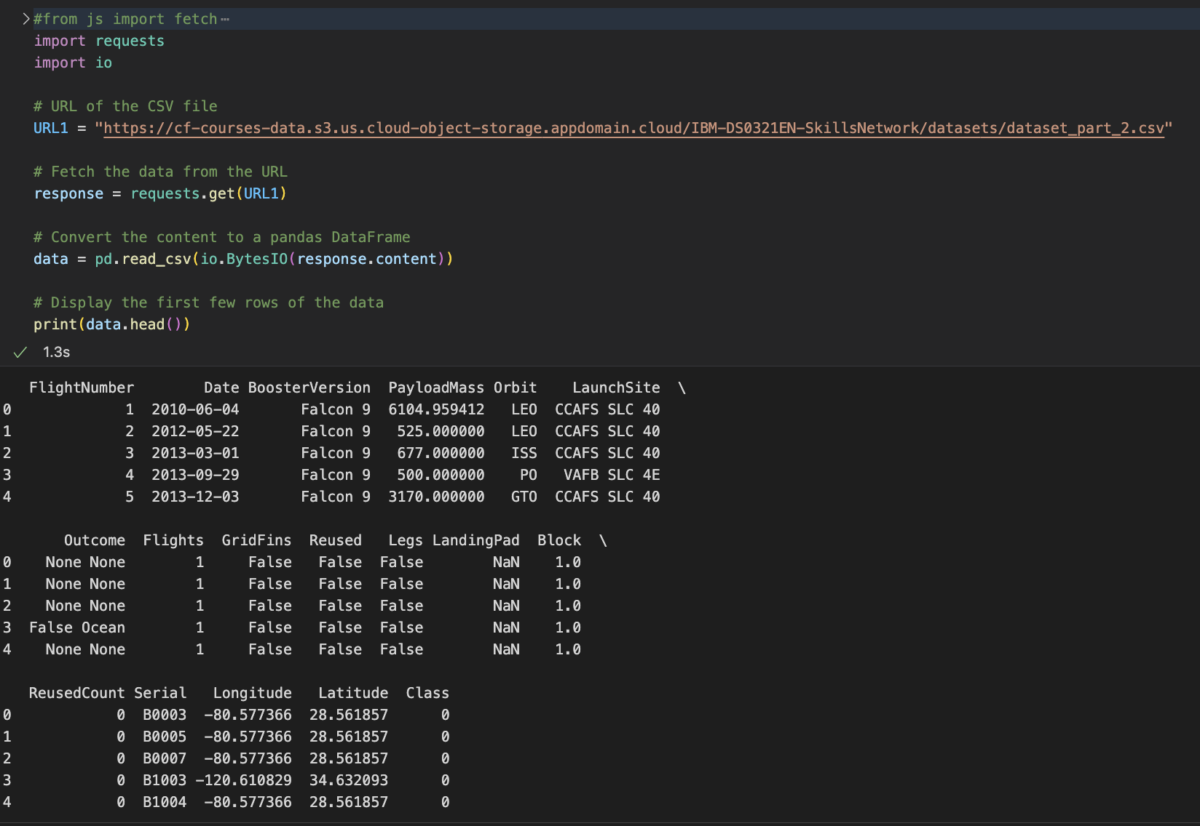
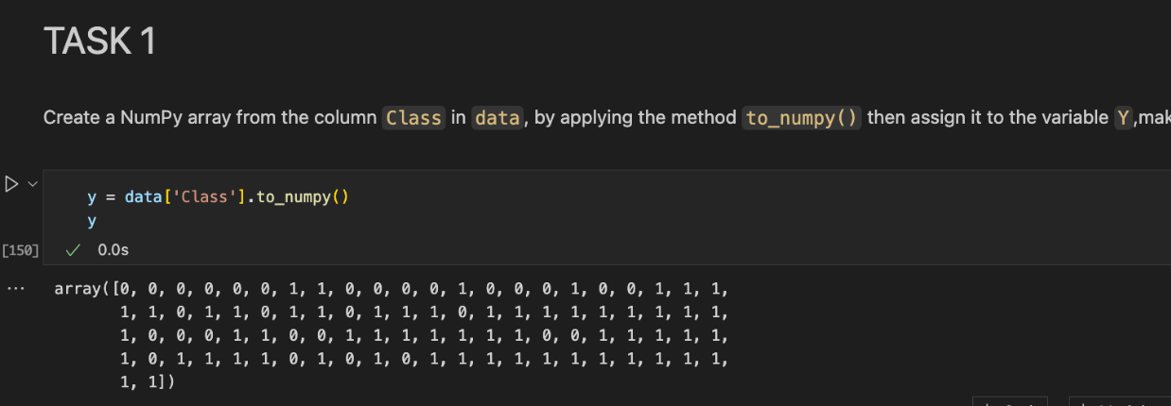
Predictive analysis (classification)
Getting (y) Class
Fetching data ready from url1 in order to get the predicted class that we want to predict with the algorithms of ML.

Slide 20
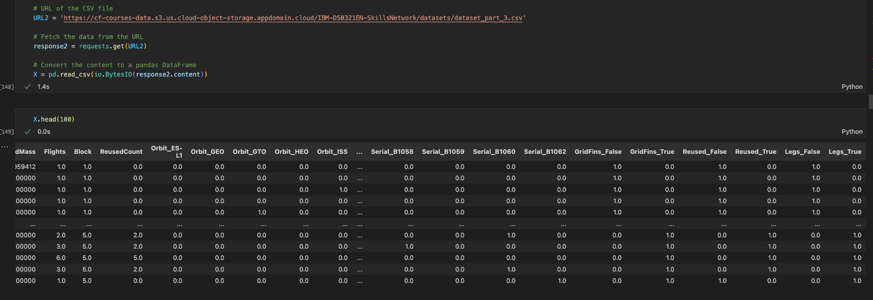
Predictive analysis (classification)
Getting (X) Features
Fetching data ready from url2 to get X or the features that will help us to predict the y class

Slide 21
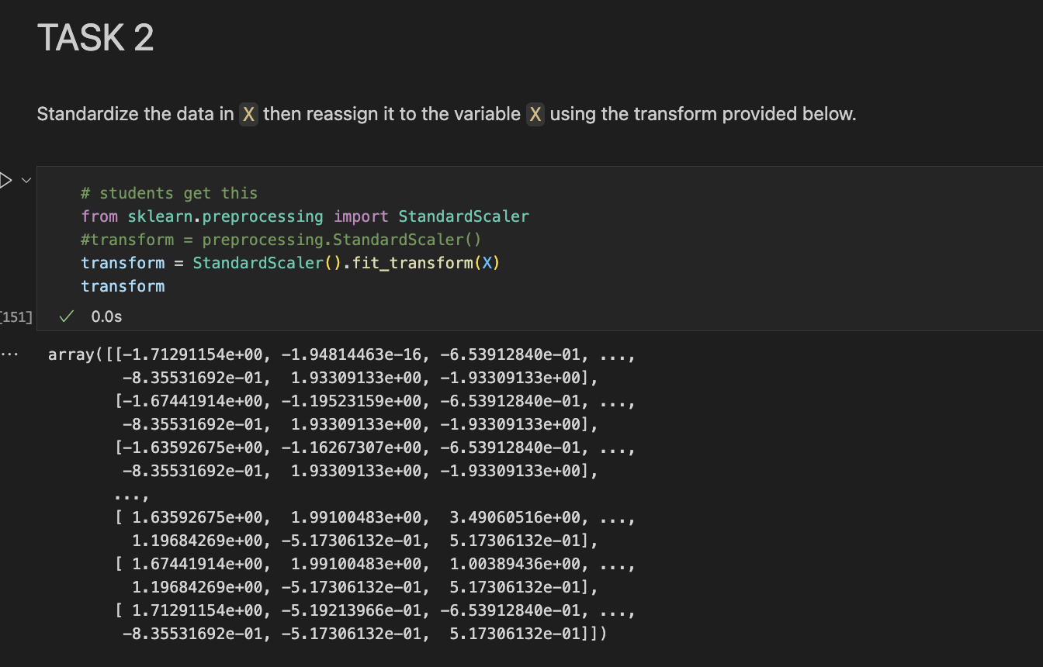
Predictive analysis (classification)
Data Standardization
Standardizing (X) to prepare the data for using machine learning algorithms.

Slide 22
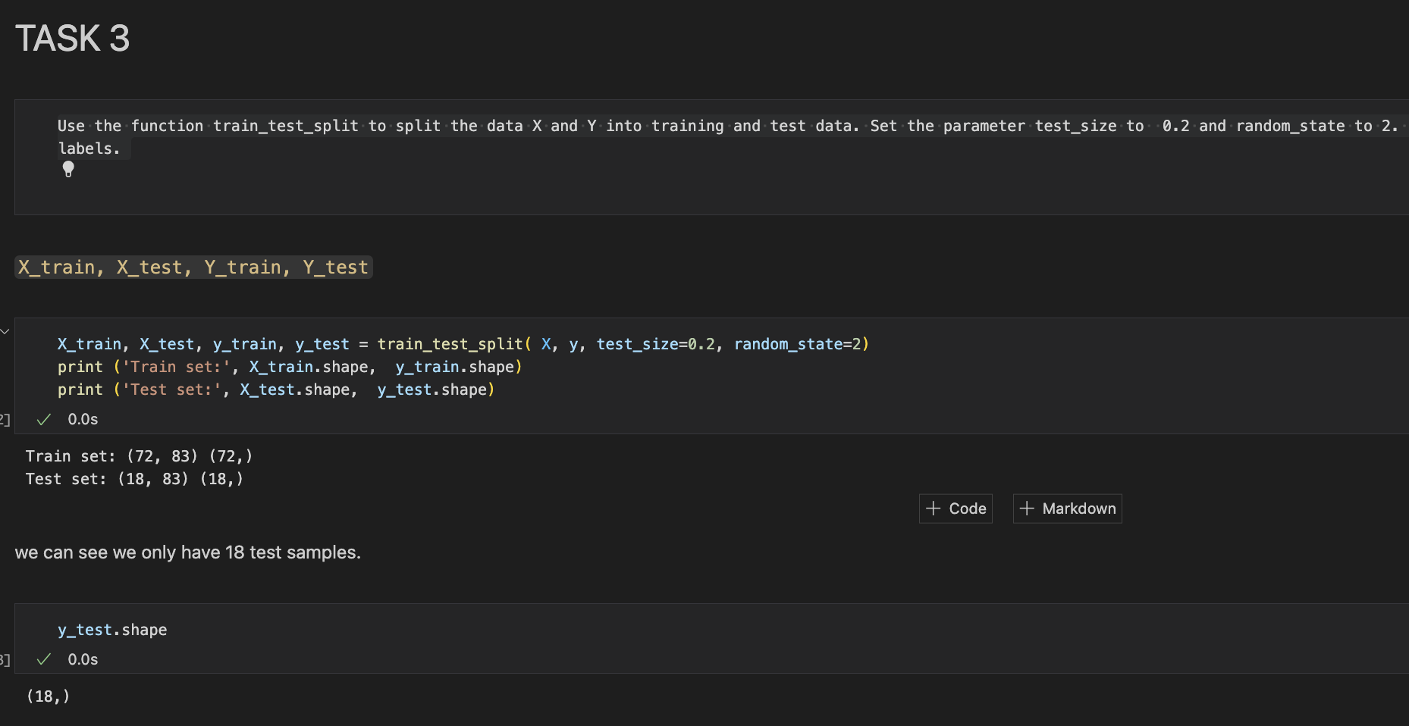
Predictive analysis (classification)
Splitting Data
Using the function train_test_split to split the data X and Y into training and test data. Set the parameter test_size to 0.2 and random_state to 2. The training data and test data should be assigned to the variables.
80% data for Training 72 rows
20% data for Testing 18 rows

Slide 23

Predictive analysis (classification)
Using GridSearchCV to fine-tune hyperparameters for each model, ensuring optimal performance.
GridSearchCV is used to optimize the hyperparameters of machine learning models to achieve the best possible performance.
This object will be runned for these algorithms: Logistic Regression, Support Vector Machine, Decision Trees, and k nearest neighbors KNN

Slide 24
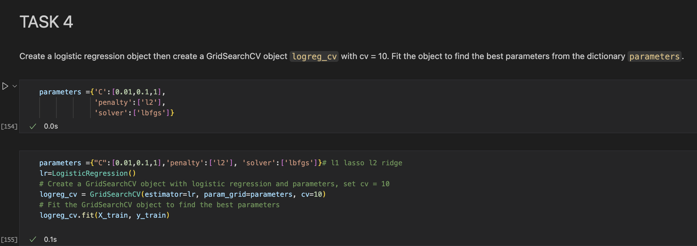
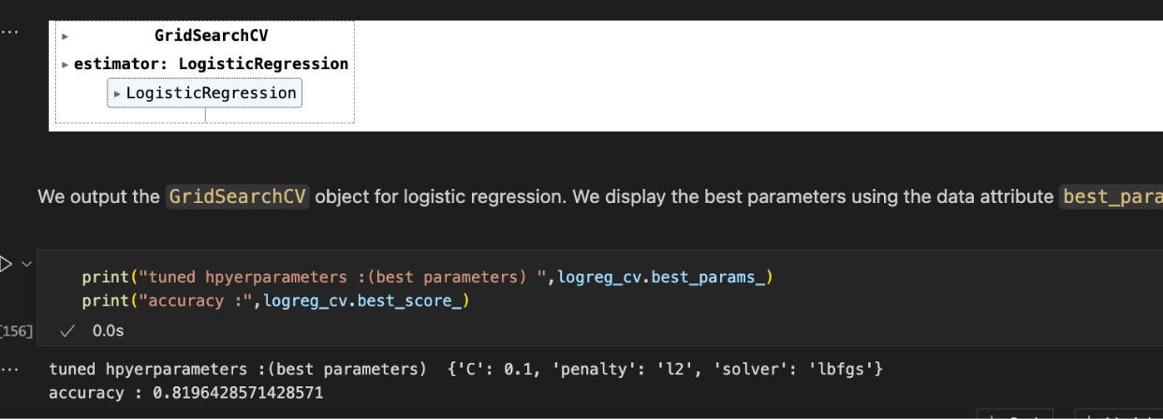
Logistic Regression
Using GridSearchCV
After run GridSearchCV we get the best parameters for LR in the variable logreg_cv.best_params_

Slide 25
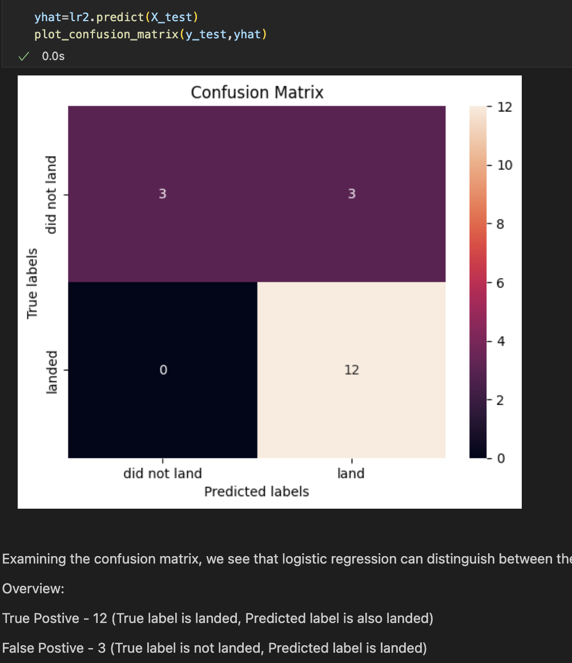
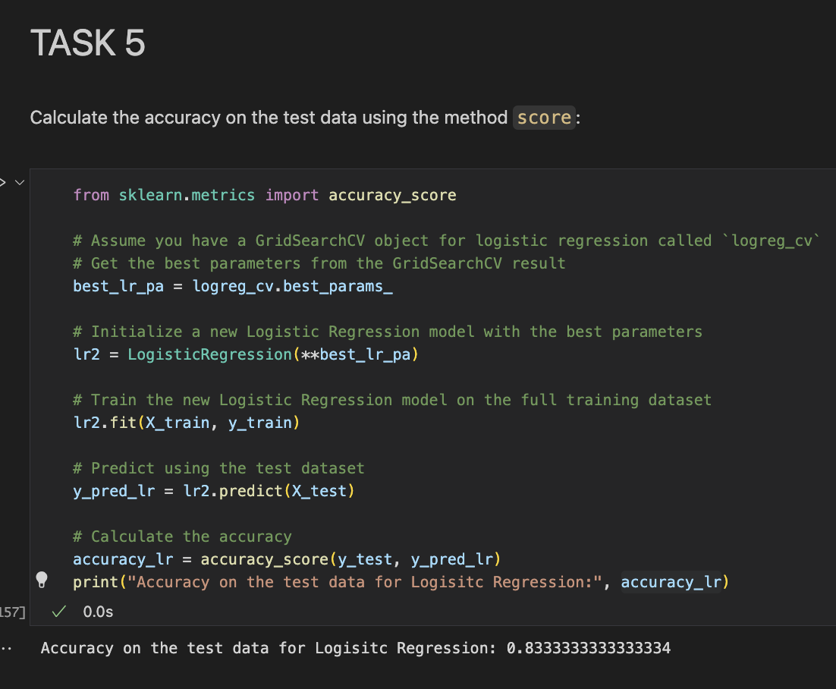
Logistic Regression
Accuracy and Confusion matrix
With the best parameters: logreg_cv.best_params_
we set the model up and now we can train it with the train set. Then we can predict using the test set to get the accuracy of the model:
Accuracy: 83%_
Notes:
The model shows a good overall accuracy of 83%, indicating it correctly predicts most of the outcomes.
The confusion matrix highlights that the model is better at correctly predicting when the rocket will land (12 true positives) and when it will not (3 true negatives), with no false negatives.
However, there are some false positives (3), meaning the model occasionally predicts a successful landing when it does not occur. This suggests that while the model is fairly reliable, there is room for improvement in reducing false positive rates.

Slide 26
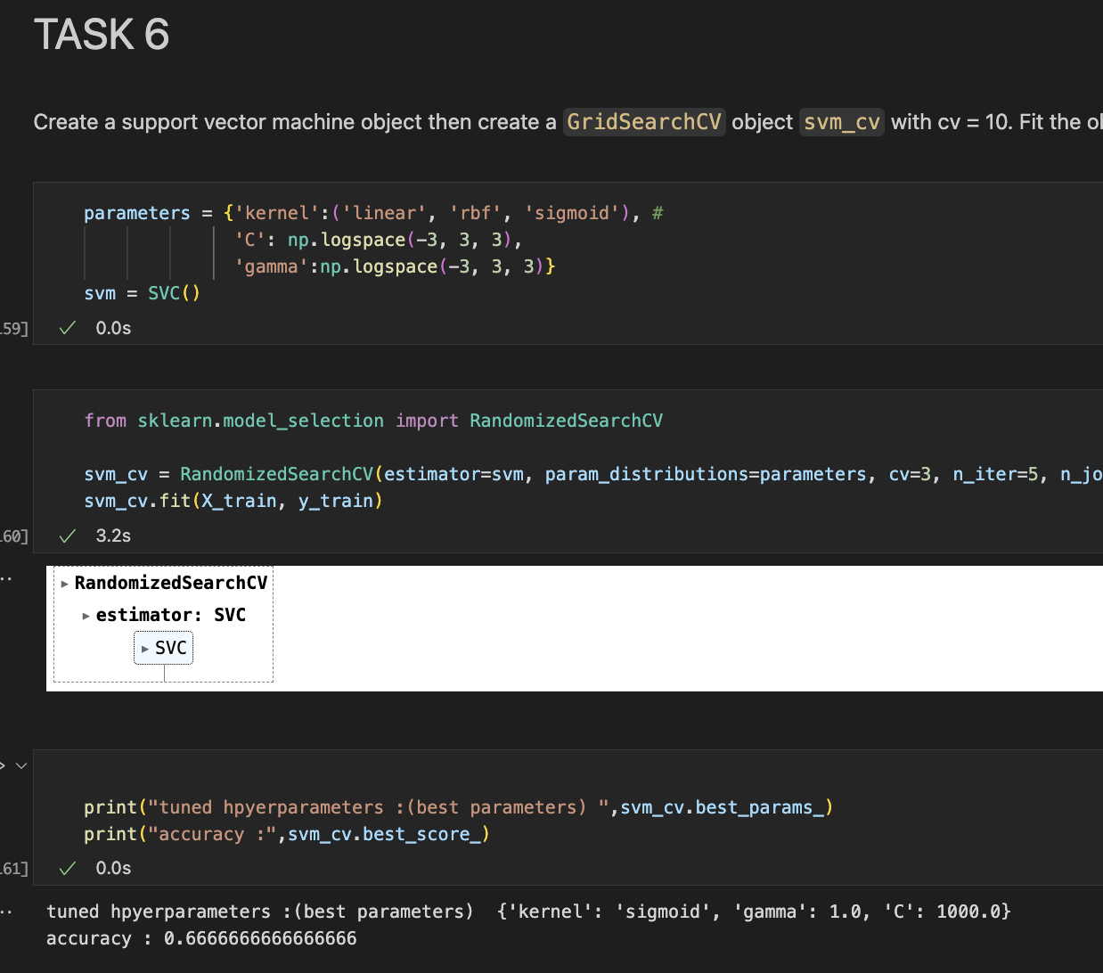
Support Vector Machine
Using GridSearchCV
After run GridSearchCV we get the best parameters for SVM in the variable svm_cv.best_params_

Slide 27
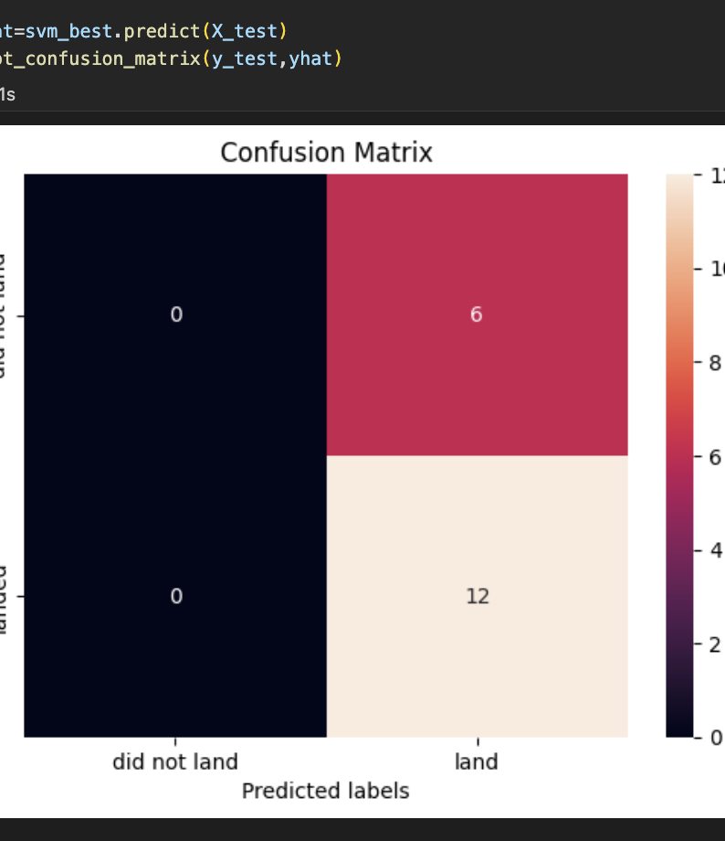
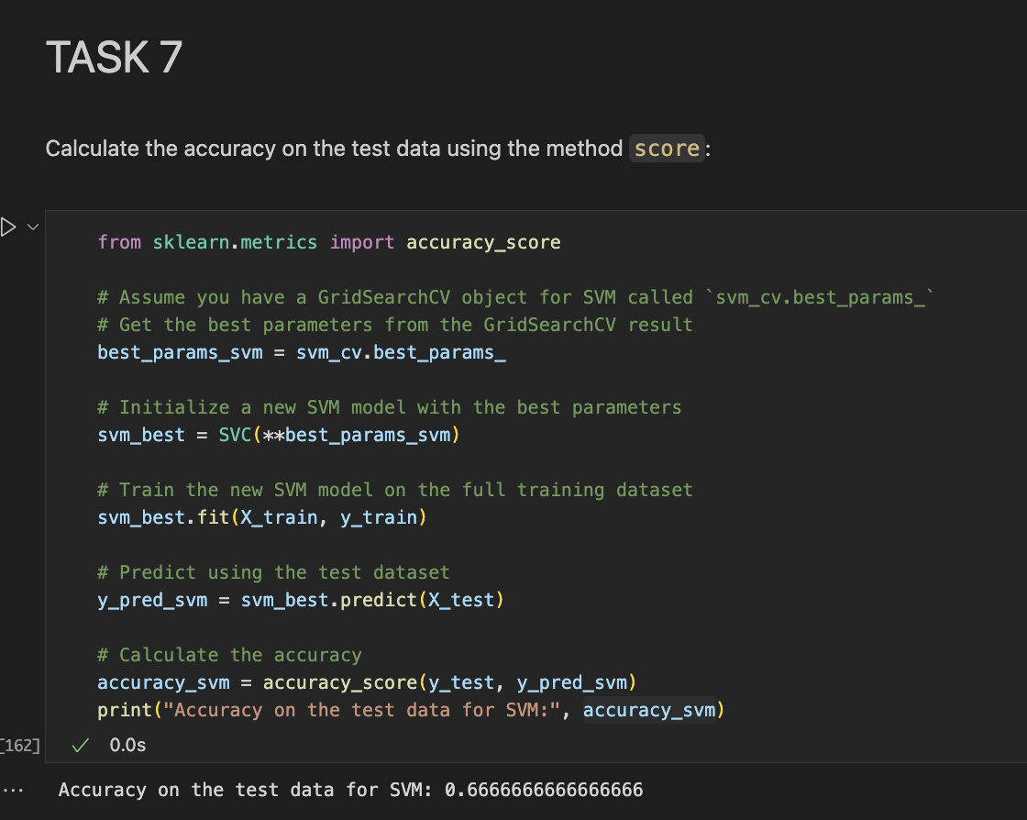
Support Vector Machine
Accuracy and Confusion matrix
With the best parameters: svm_cv.best_params_
we set the model up and now get train it with the train set. Then we can predict using the test set to get the accuracy of the model:
Accuracy: 66%_
Notes:
• The SVM model shows a lower accuracy of 66%, indicating it has more difficulty correctly predicting outcomes compared to the Logistic Regression model.
• The model has a significant number of false positives (6), meaning it frequently predicts a successful landing when it does not occur. This suggests the model is overly optimistic in predicting landings.
• There are no true negatives, implying the model fails to identify any cases where the rocket does not land successfully.

Slide 28
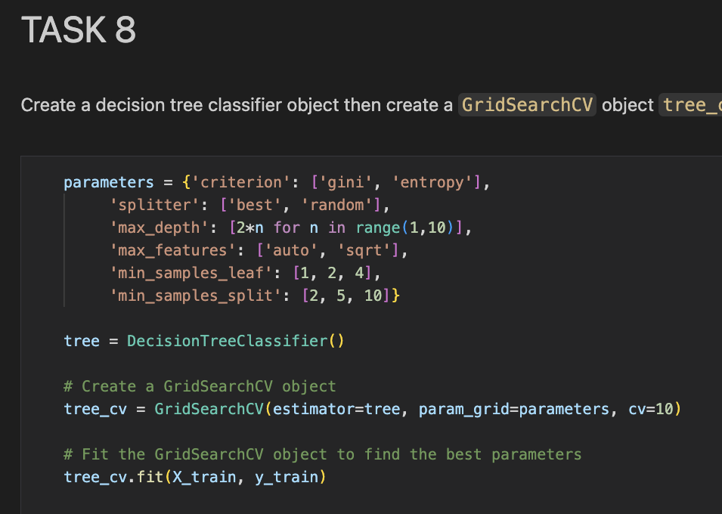
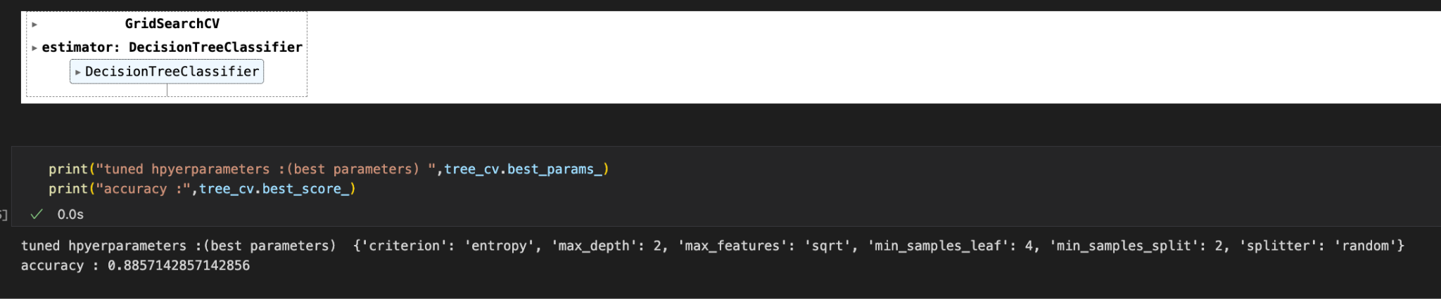
Decision Tree
Using GridSearchCV
After run GridSearchCV we get the best parameters for SVM in the variable tree_cv.best_params_

Slide 29
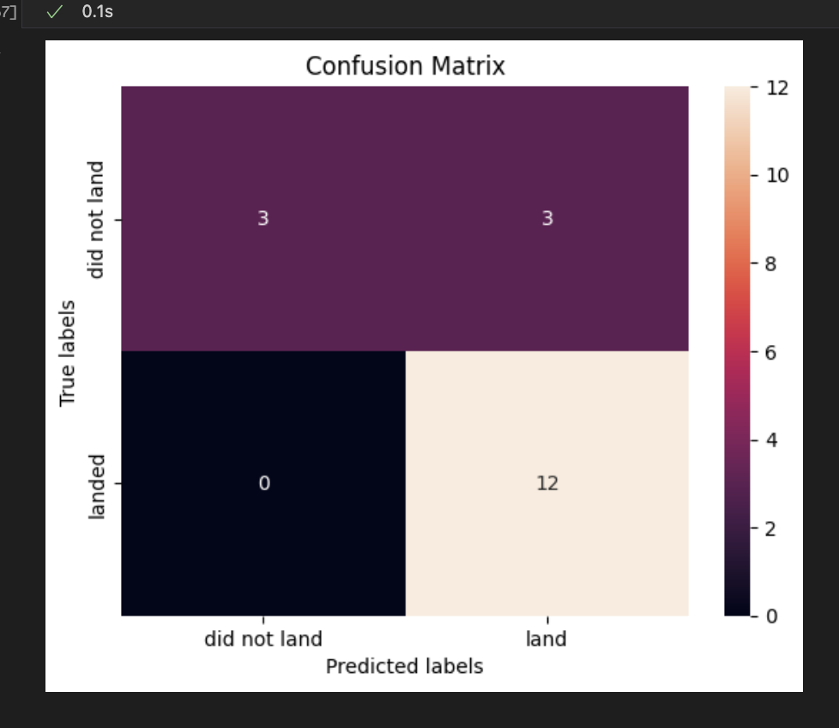
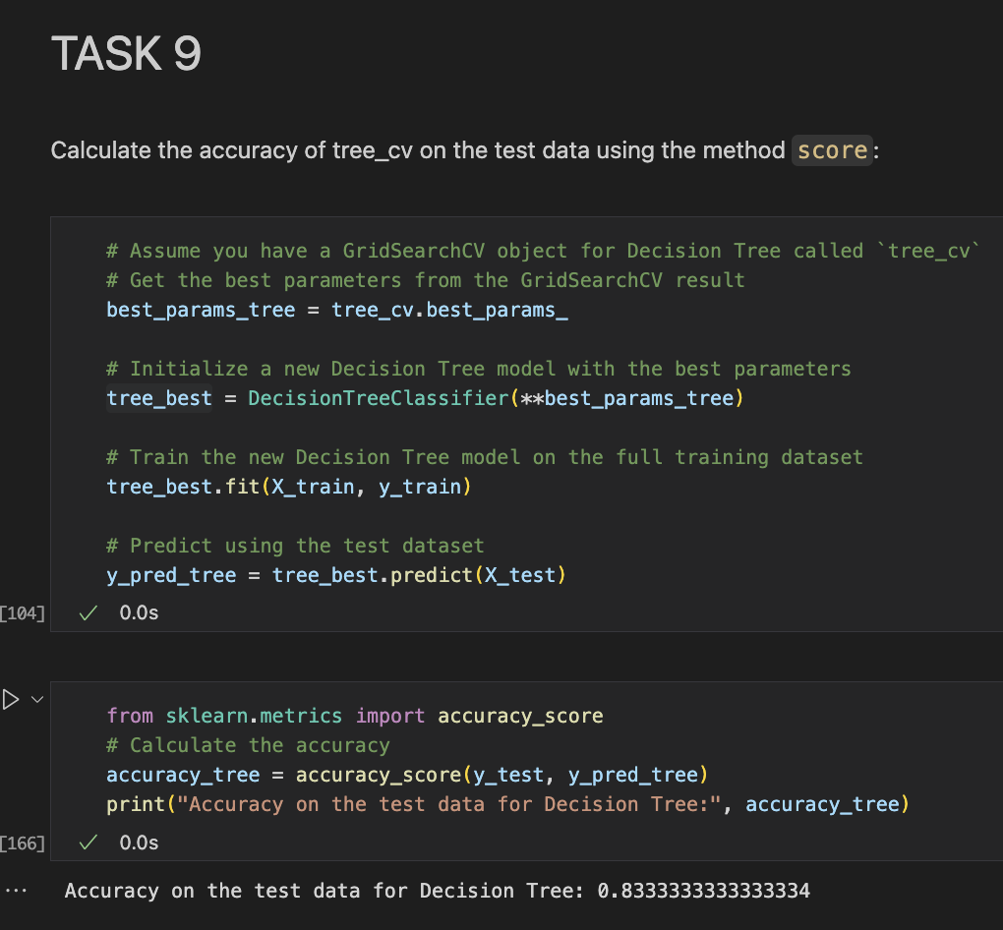
Decision Tree
Accuracy and Confusion matrix
With the best parameters: tree_cv.best_params_
we set the model up and now get train it with the train set. Then we can predict using the test set to get the accuracy of the model:
Accuracy: 83%_
Notes:
• The Decision Tree model shows an accuracy of 83%, indicating a strong performance in predicting the landing outcomes.
• The model successfully identifies most of the positive cases (landed), with 12 true positives and 3 true negatives.
• The presence of 3 false positives suggests the model occasionally predicts a landing success when it does not occur, similar to the Logistic Regression model.
• The absence of false negatives indicates that the model reliably predicts all instances where the rocket successfully landed.

Slide 30
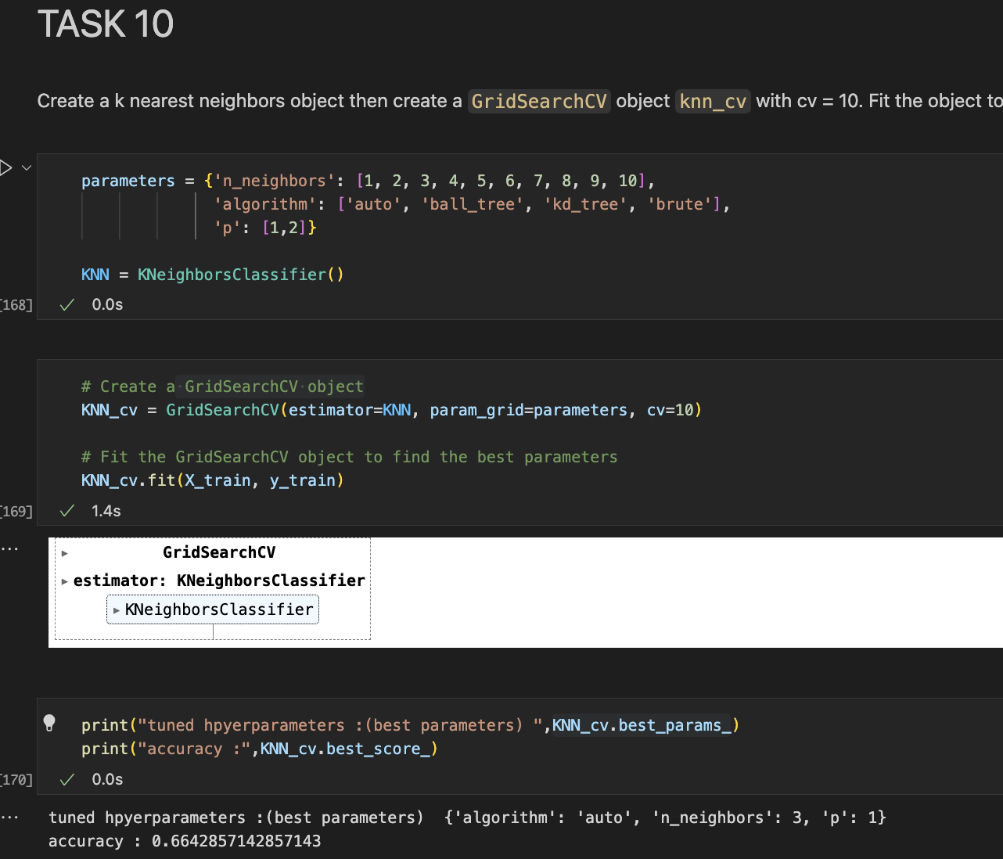
K Nearest Neighbors KNN
Using GridSearchCV
After run GridSearchCV we get the best parameters for SVM in the variable KNN_cv.best_params_

Slide 31
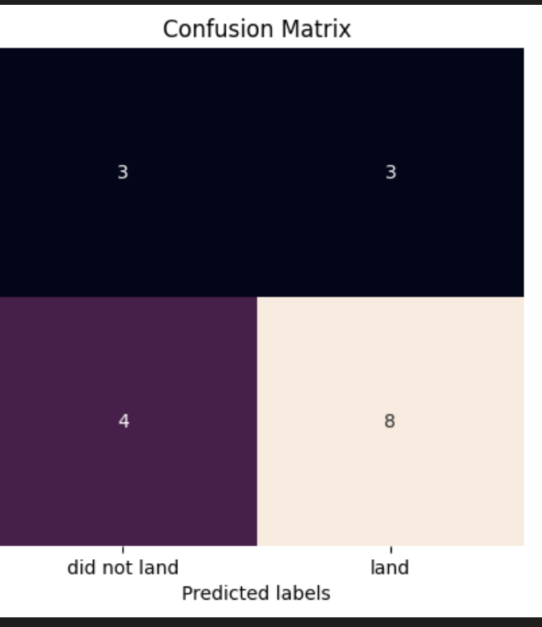
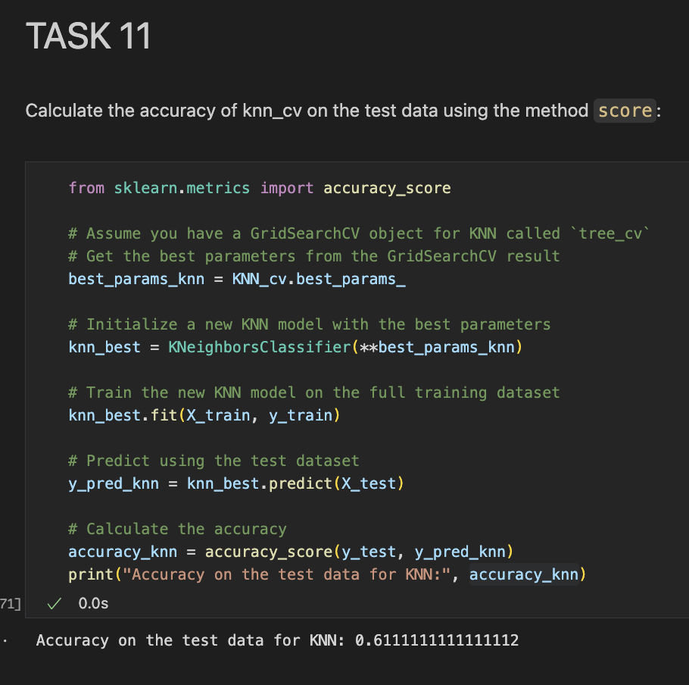
K Nearest Neighbors KNN
Accuracy and Confusion matrix
With the best parameters: KNN_cv.best_params_
we set the model up and now get train it with the train set. Then we can predict using the test set to get the accuracy of the model:
Accuracy: 61%_
Notes:
• The KNN model has an accuracy of 61%, indicating it is less reliable compared to other models, such as Logistic Regression and Decision Tree.
• The model has a balanced number of correct predictions for both classes (3 true negatives and 8 true positives), but there are significant errors, including 3 false positives and 4 false negatives.
• The presence of 4 false negatives suggests that the model struggles more in correctly predicting successful landings.

Slide 32

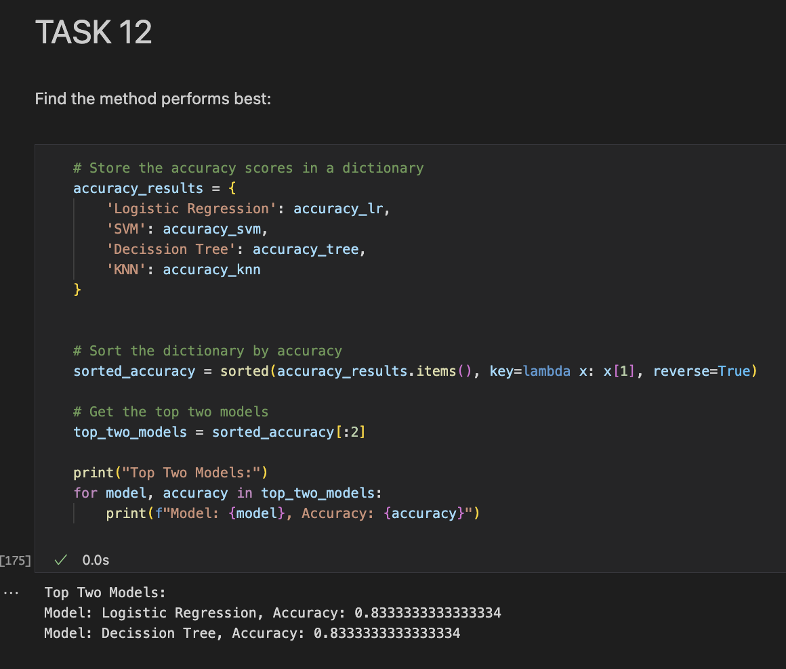
Best Model predictive Classification
Logistic Regression, and
Decision Tree, perform well predicting the successful landing
Image source: Image created by DALL-E, September 2024.

Slide 33
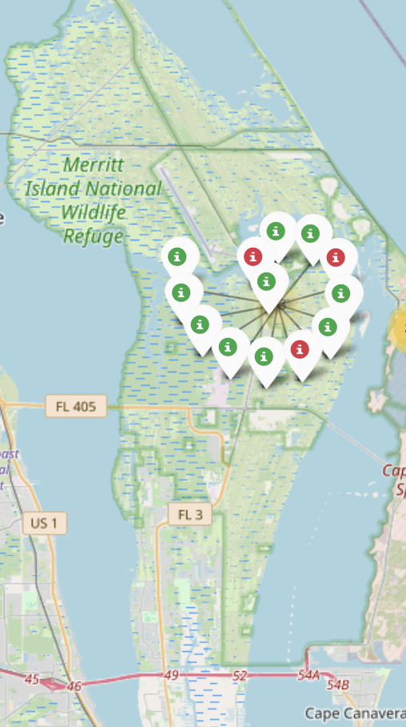
Interactive maps with Folium
To analyze and visualize SpaceX launch sites geographically, we used Folium, a powerful Python library for creating interactive maps directly within the notebook.
Approach
Mapped all SpaceX launch sites, including CCAFS SLC 40, VAFB SLC 4E, and KSC LC 39A.
Added markers and tooltips to display site names, coordinates, and launch details.
Analyzed geographical factors and their potential impact on launch success.
Benefits
Provides intuitive, interactive insights into spatial data.
Highlights patterns and trends related to launch site selection and outcomes.
Image source: local python file running in Visual Studio Code (1.92.2) in Macbook Pro M1

Slide 34
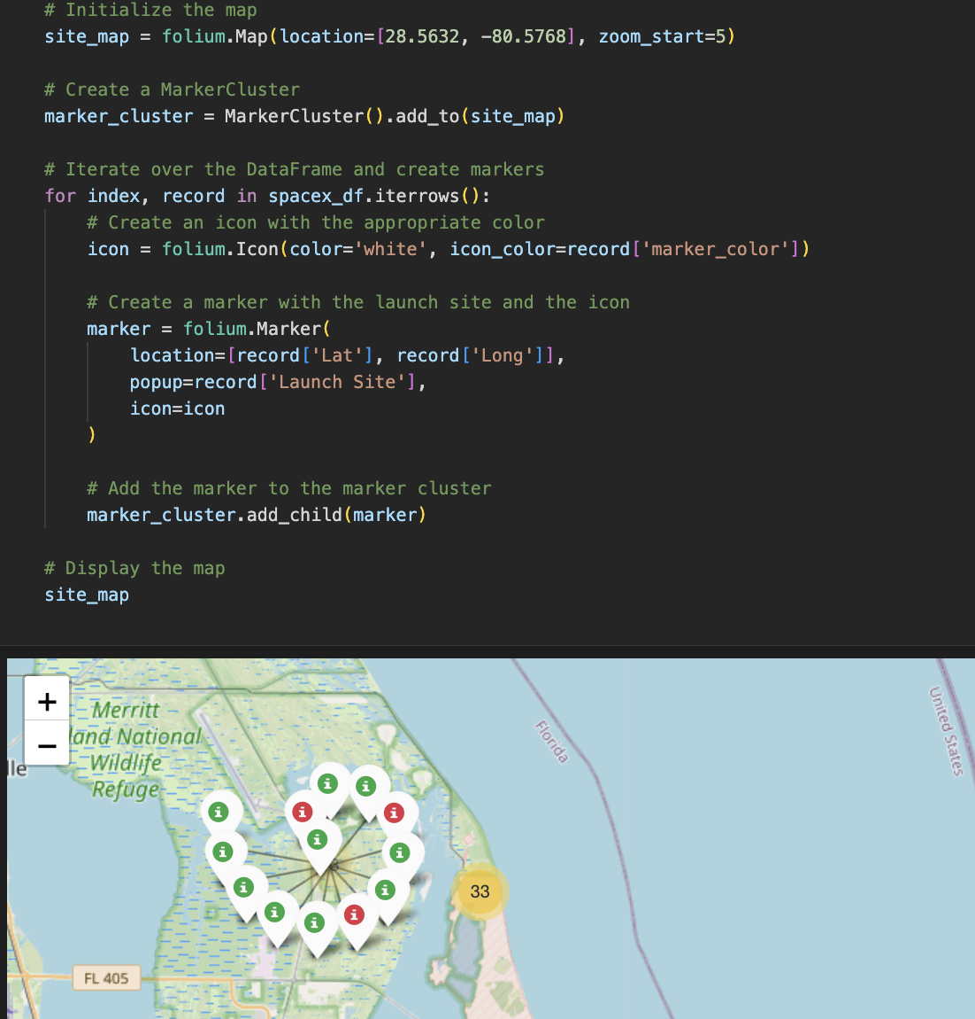
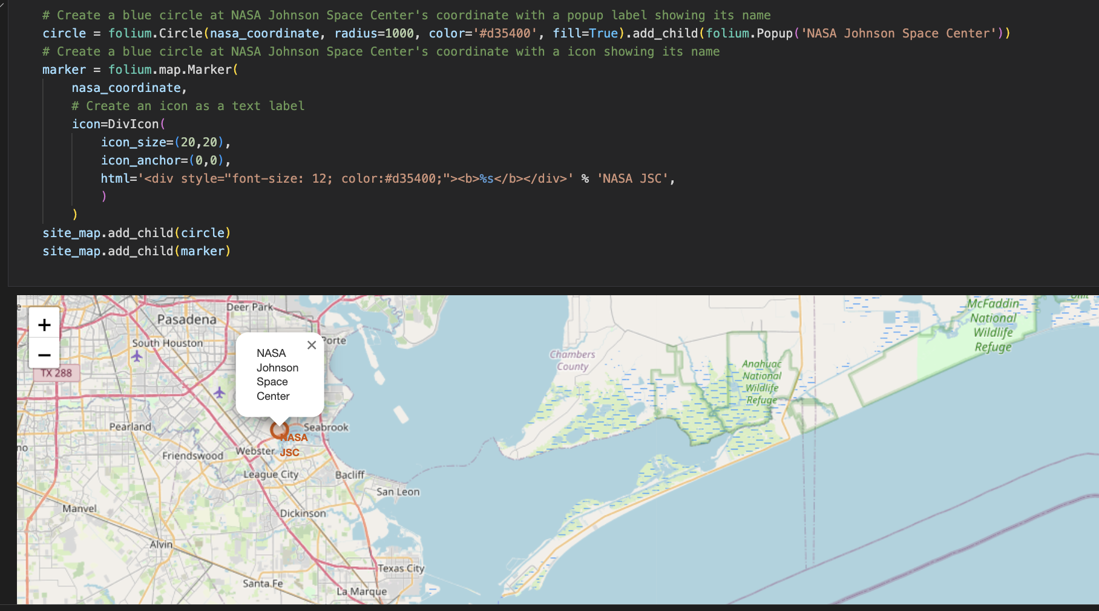
Interactive maps with Folium
Creating maps in this project is crucial for visualizing the spatial relationships between launch sites and their outcomes, revealing patterns and trends influenced by location. For instance, mapping shows how proximity to water and isolation of launch sites are strategic factors in minimizing risk to people in case of accidents.
Displaying locations and adding text label on a specific coordinates
Displaying market clusters for each launch sites and showing success and fail landing rockets site.

Slide 35
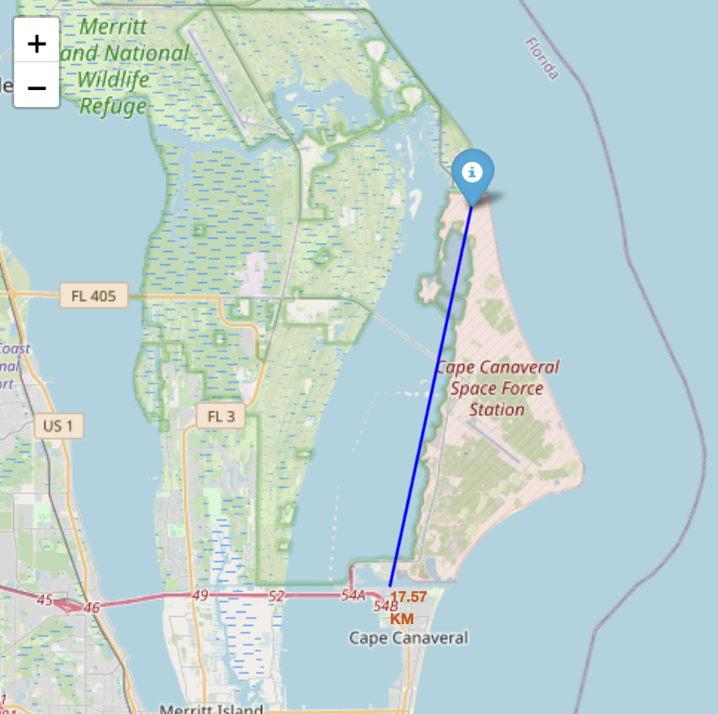
Interactive maps with Folium
Showing the distance of 17.57km from a launch site (CCAFS SLC-40) to the closer city (Cape Canaveral).
We are able to answer:
Are launch sites in close proximity to railways?
Are launch sites in close proximity to highways?
Are launch sites in close proximity to coastline?
Do launch sites keep certain distance away from cities?

Slide 36
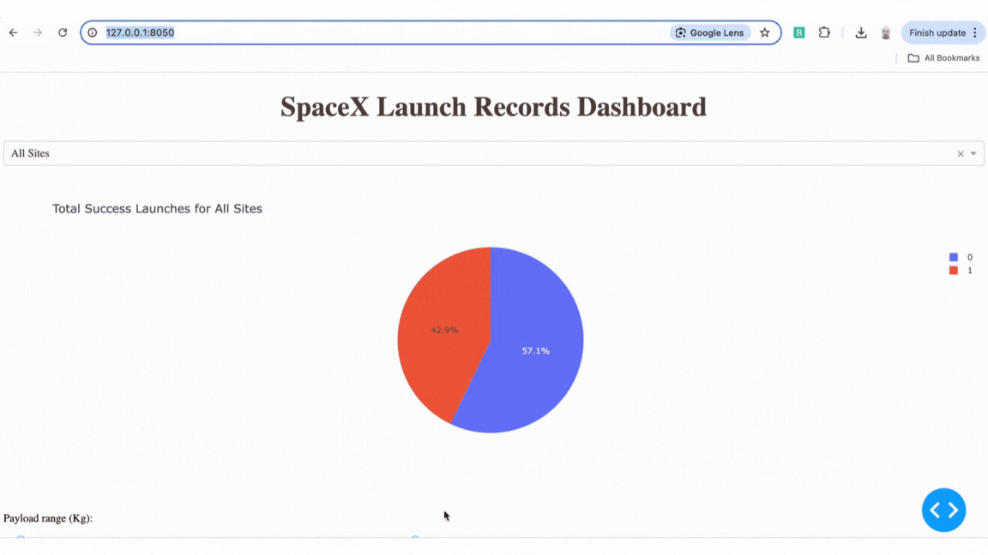
Plotly Dash dashboard
This Plotly Dash dashboard provides an interactive platform to visualize key metrics and trends related to SpaceX Falcon 9 launches. It features various elements, such as the success rate by launch site, which highlights site-specific performance, and an analysis of how payload mass affects the likelihood of a successful landing. The dashboard offers a dynamic, user-friendly way to explore data, identify patterns, and gain valuable insights, ultimately supporting data-driven decision-making for future launches.
Image source: local python file running in Visual Studio Code (1.92.2) in Macbook Pro M1. Gif created in Canva

Slide 37
Conclusion
Model Performance: The Logistic Regression and Decision Tree models demonstrated the highest accuracy and balanced performance across key metrics, making it the best choice for predicting Falcon 9 first-stage landing success.
Key Insights:
The Support Vector Machine (SVM) and K-Nearest Neighbors (KNN) models had lower accuracy and struggled with prediction errors, particularly false positives and false negatives.
Enhanced Data Visualization: Interactive maps and dashboards effectively visualize complex data, making it easier to identify patterns and trends in SpaceX launch outcomes.
Implications for Space Y: Accurate predictions of landing success can optimize mission planning, reduce costs, and enhance decision-making processes for future launches.
Future Recommendations:
Further model tuning and exploration of additional features could improve prediction accuracy.
Consider using ensemble methods or advanced techniques such as deep learning to enhance model performance.

